Slide 1
Mapping in R
R Training Sessions 4
10/19/2018

Slide 2
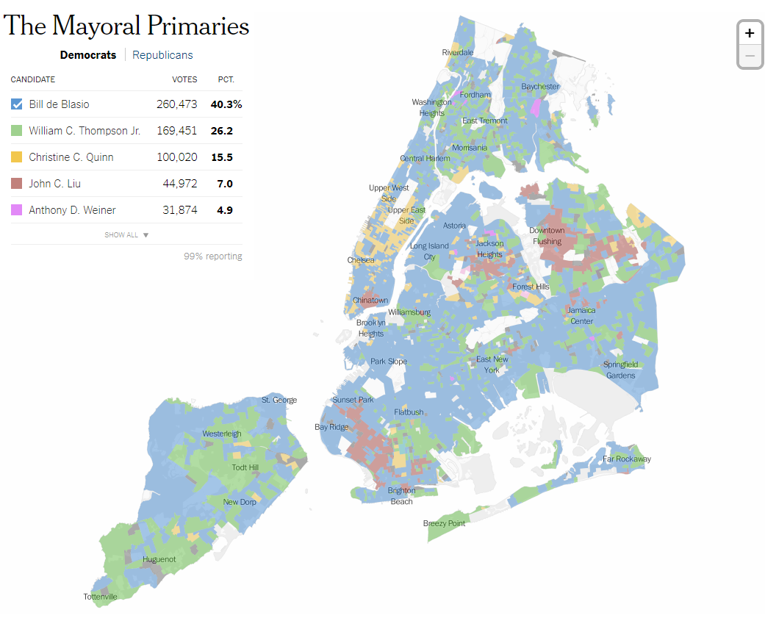
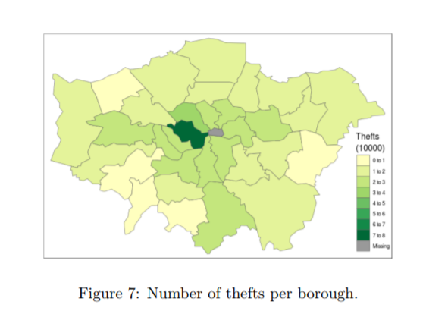
Maps
Static & Interactive Maps
made with leaflet()
made with ggmap()

Slide 3
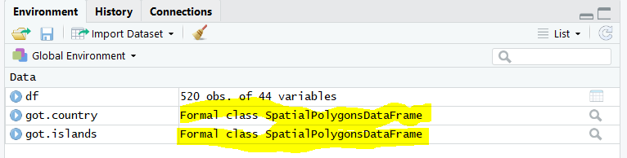
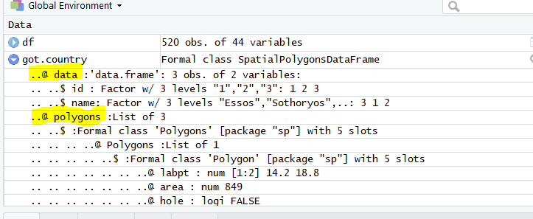
Spatial Data
Points, Lines, Polygon, Coordinates, Raster
Nested data made up of slots that can be called using @
GoT_Regions@data
GoT_Regions@polygons

Slide 4
Packages
rgdal: R’s interface to the “Geospatial Abstraction Library (GDAL)” (also used by QGIS)
Required to read shape files
readOGR(dsn=‘GoT_Regions’, layer = ‘continents’)
OGR: OpenGIS Simple Features Reference Implementation (refers to a GIS file)
dsn: data source name (folder that contains the shape files)
layer: OU or Regions or SNU level that you want to display on the map
rgeos: extract data from shape files
sp: used to create points, lines, polygon data

Slide 5
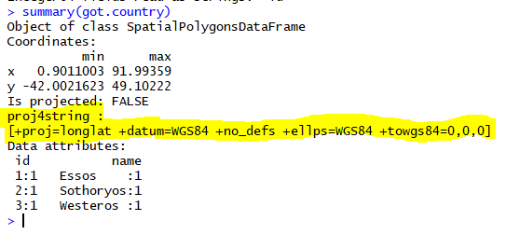
Coordinate Reference System (CRS)
Defines coordinate’s place on the Earth’s surface
Represented in R as ‘proj4string’
Spatial data must have a CRS, or it can’t be plotted on open street maps (OSM) or Google maps
Can still be plotted without background world map
Find CRS – proj4string(got.country)
Set CRS
proj4string(got.country) <- CRS("+init=epsg:4326“)

Slide 6
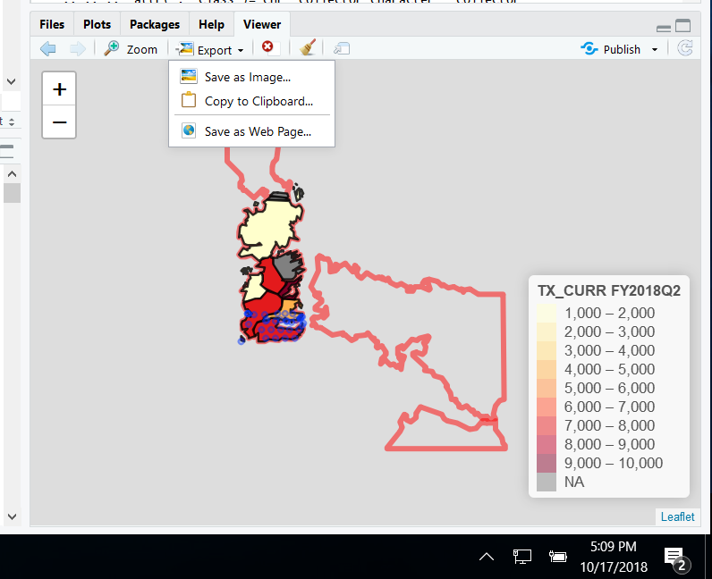
Leaflet
Javascript library for interactive maps in R
Create maps with leaflet()
Add layers for polygons, markers, popups
Export as html or jpeg and share
Learn more: https://rstudio.github.io/leaflet/
Great resource to learn about different options in leaflet

Slide 7
Useful Resources
https://rstudio.github.io/leaflet/
Spatial data & ggmap: https://cran.r-project.org/doc/contrib/intro-spatial-rl.pdf
Spatial data cheatsheet: https://www.maths.lancs.ac.uk/~rowlings/Teaching/UseR2012/cheatsheet.html
Leaflet Cheatsheet: https://ugoproto.github.io/ugo_r_doc/leaflet-cheat-sheet.pdf
http://spatial.ly/r/

Slide 8


Discussion & Evaluation

